Slide 1

MTD: MOOD TOOLKIT DASHBOARD A Data Analytical Web Application for Psychological Research Studies
Master’s Project Defense
By: Dheeraj P. Srivatsav
Advisor: Dr. Yi Shang

Slide 2
OUTLINE
Introduction
Related Work
Design & Implementation
Results
Conclusion & Future Work
Notes:
Introduction --- Problem. Solution. Overview of the App
Conclusion --- Conclusion, References

Slide 3
OUTLINE
Introduction 1. Problem Description 2. Proposed Solution 3. Web Application Dashboard Overview
Related Work
Data Overview
Methodology & Implementation
Results
Conclusion & Future Work

Slide 4
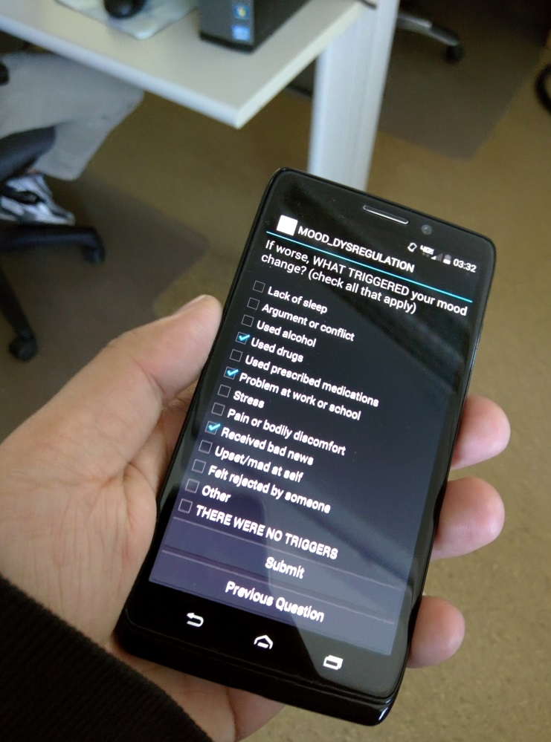
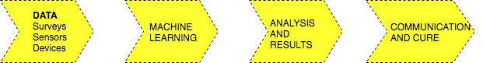
Introduction
Mood ToolKit - A currently successful and highly popular survey based research
Ambulatory Assessment -To study physiological and physiological metrics from Sensors
High Frequency points of Survey and Sensor Data, collected, cleaned, processed and analyzed.
Studies - Alcohol Craving, SLU Watch, NIMH
Existing Pipeline
Notes:
1. A currently successful and highly popular research being undertaken by MU department of Psychology
2. Collect data from apps and use it to study different kinds of features, patterns and disorders from the participants. Data collected from the apps, cleaned, processed and studied to influence decision making. Most of them Based on Mood change and substance usage
3. All the 3 studies in action: SLU Watch, Alcohol Craving and NIMH
1. methods are being employed to optimize collection and storage, some web service implementation
4. Existing Pipeline

Slide 5
Problem
All Survey and Sensor raw data. No application oriented approach
Researchers don’t have easy access to all data
Display of Key metrics can influence decisions
Manual calculation and graphing of key metrics
No Visualization for such data intensive studies
3 Different data sets available which can be used for analysis and building a web based application
Notes:
There is plenty data, just stored as CSV files on BOX:
An application oriented approach can collect, congregate and show all data at one place
As in the case of any business, KPI influence decision making, compliance, days in study, number of available surveys.. Can help decide whether to pursue with the participant or not
2. In previous research, have used manual calculation for finding the key metrics and deciding whether to move forward with a record or not. That might be a long process and may be error prone. Can save some time and they focus their efforts on ML
3. Bunch of excel sheets, high frequency records, in cases 1row per second.. Surely having an application visualizing it will help a lot
4. If it was just a one-off dataset, not much motivation, because there are many similar datasets, a huge motivation to combine and congregate the data
All the data is used for ML , yes, but for lower level metrics and providing ease of access. Helps MU department of Psychology

Slide 6
Proposed Solution
Missing piece of an existing pipeline - MTD Web Application
Modular application
Providing ease of access - All studies on one server
Easy to use, a framework available to add/extend studies
Use disparate data sets and present a hierarchical visualization scheme
Full stack development using industry standards
LAMP Stack and AngularJS framework
MVC Architecture
Notes:
What pipeline?
Something which Luke, Nick, Will and Peng are working on . There is App from Will, there is the cleansing done by Luke, Nick and Peng implement ML and Analysis, so a web front will help in ease of access and create a location for everything at one place
Industry standard practices
Full stack, not just static web pages LAMP stack hosted on ec-2
MVC arch allows a modular design for building UI applications – will talk about this later

Slide 7

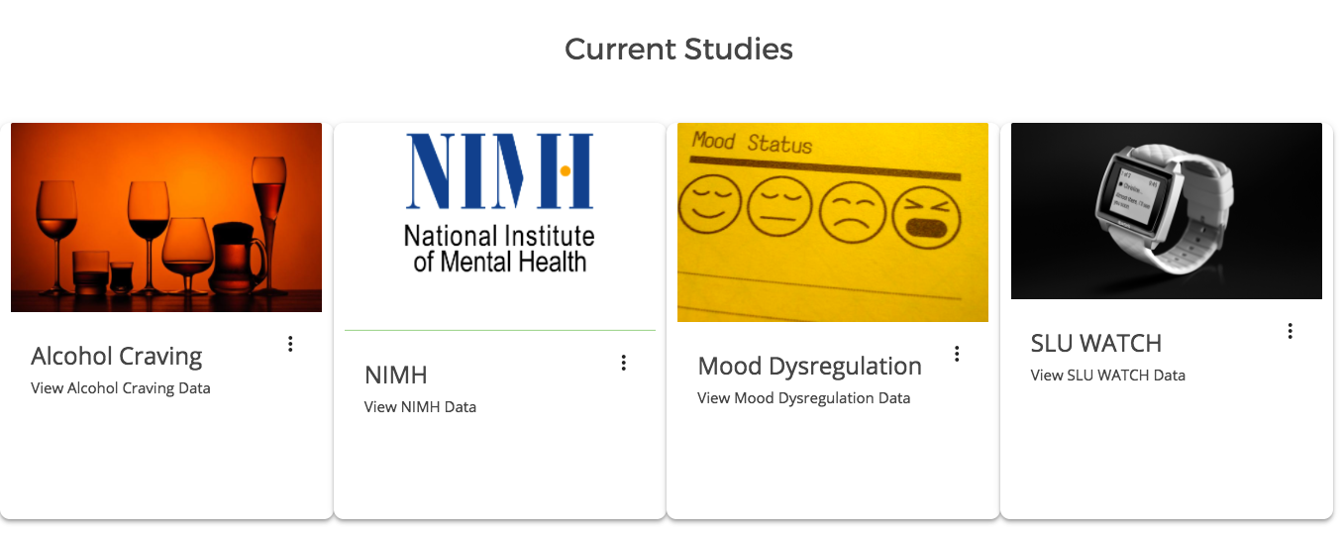
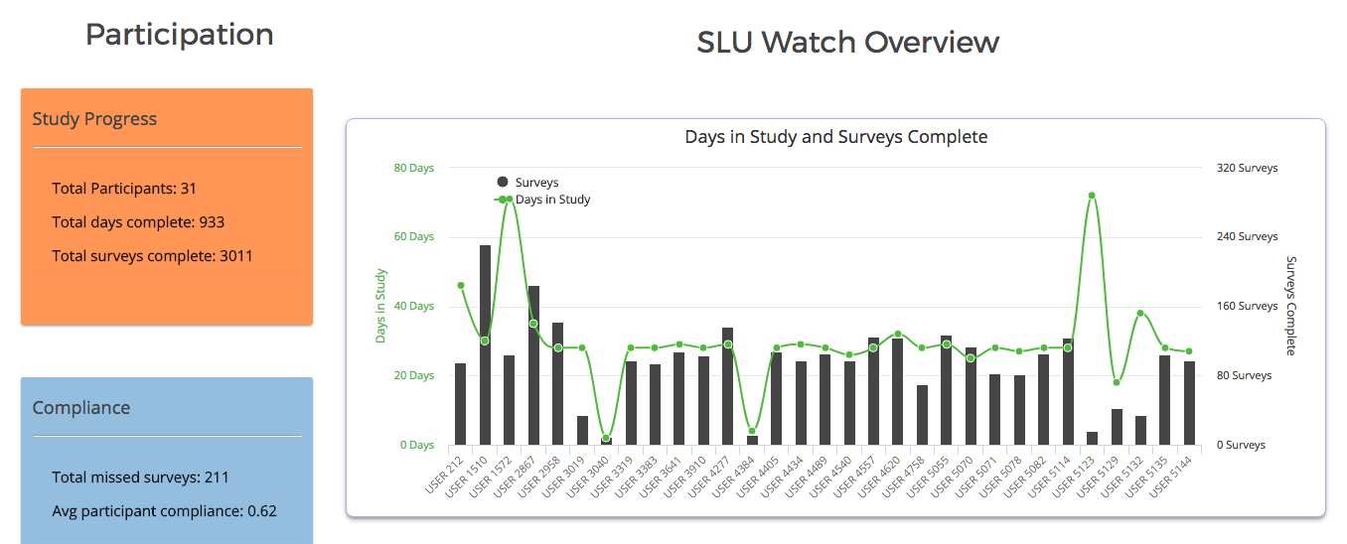
Mood ToolKit Dashboard Overview
Notes:
A web application is one which has 3 components of a business logic
DB , GUI and a Web Server
A dashboard shows key metrics which determine research focus and influences business decisions
An application oriented approach using software development techniques allows a good addition

Slide 8
OUTLINE
Introduction
Related Work
Data Overview
Methodology & Implementation
Results
Conclusion & Future Work

Slide 9
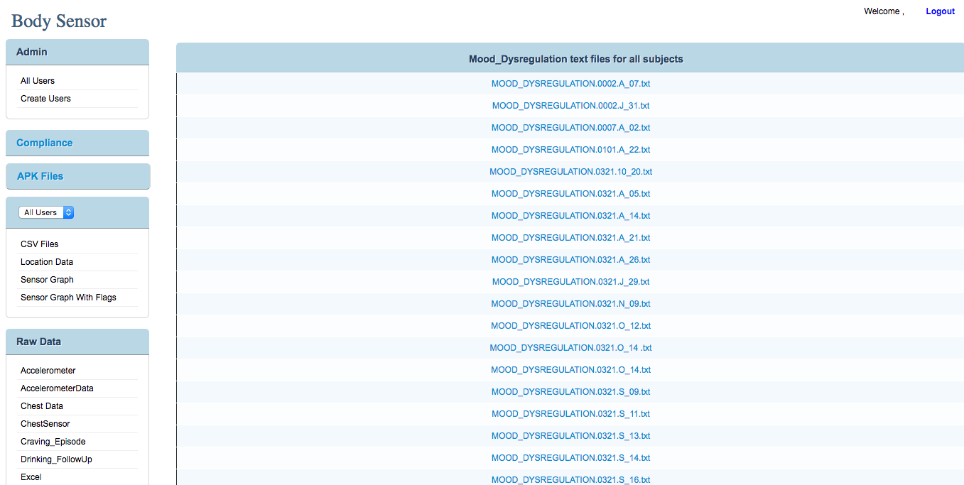
Related Work
As part of mAAS [1]
Helped understanding data and study
Emphasis on Mobile App, Data storage and a simple web interface
Web server implementation - Monolithic Architecture
Single Study – NIMH
Flat file system structure. Mostly Text Files not graphs
1. Ruiqi Shi, “An Enhanced Mobile Ambulatory Assessment System for Alcohol Craving Studies”, University of Missouri, Department of CS in Master’s Thesis, April 2015.
Notes:
A web-based dashboard is a web application that helps in providing multiple views of a large scale dataset. Visualization is a very important functionality
Applications built for research faculty seldom permit end-users to customize the dashboard
Monolithic architecture – No room for change, monotonous and single logic. Just PHP.
Usage of highcharts and modular development architecture overcomes certain drawbacks

Slide 10
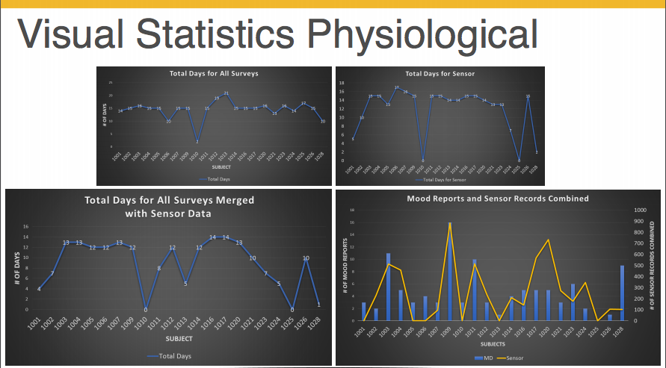
Related Work (cont.)
2. As part of AMD [2]
Also helped with understanding data (NIMH)
Completely into Machine Learning Pipeline
Key analytical metrics were defined which were useful
Manual Calculation and graphing of key metrics
Motivation:
Develop Readily available Web Application using recommended industry practices having robust and modular design
2. N. M. Wergeles, “AMD: ANALYSIS OF MOOD DYSREGULATION A Machine Learning Approach”, University of Missouri, Department of CS in Master’s Thesis, 2016.
Notes:
All these graphs were used as part of data collection and cleaning and then decision were made if whether to use it or not
But a readily available application showing key metrics like these would help them make decisions quickly and move on to their part of research
Motivation ?? Building data analytical dashboards on a web front using recommended practices and make use existing idle data .
Key characteristics of such UIs are
single-page interface
data loaded on-demand via AJAX 9 highly helpful as lot of data here)
highly modular design, easily interpretable code logic and client-side view generation.

Slide 11
OUTLINE
Introduction
Related Work
Data Overview
Methodology & Implementation
Results
Conclusion & Future Work

Slide 12


Data Overview
3 different ambulatory assessment studies
Studies
 | NIMH | ALCOHOL CRAVING | SLU WATCH
Total Size ( all participants) | 8MB | 10MB | 346MB
DB schema file size | 2MB | 4MB | 150MB
Participants | 33 | 24 | 31
Records | 5,300 | 13,000 | 700,000
Type | Survey | Survey | Sensor + Survey
Metrics
Notes:
Averaged from 1 per second to 1 per minute
Input Data after cleaning the raw data
overview… HOW THIS WILL BE USED AND WHAT WILL done to this data
1. Incorporated to SQL for a structured approach to retrieve data
2. Aggregation of data to find key points of interest.. Each study had it’s own stats file with this data
3. Files count over 500 had to be cleaned and grouped
4. Available for download at participant level

Slide 13
OUTLINE
Introduction
Related Work
Data Overview
Methodology & Implementation
Results
Conclusion

Slide 14
Methodology
WHAT GOES INTO DASHBOARDS? - Involves showing relationship between meaningful data. - Relevant data grouped by Business Logic
KEY CONSIDERATIONS
Timeliness – relevant time bound data
UI Design – appealing and trendy
Interactivity – allow user actions
Data Intensiveness – more the merrier
IDEAL METRIC
ACCESSIBLE DATA
SIMPLE CALCULATION
EASY TO INTERPRET
Notes:
STRUCTURE
Show relationships – Multi level views
Provide Grouping of Data – Doesn’t mean everything should be at one place; group based on relationships, group based on metrics. ( In our case Research Logic)
KEY CONSIDERATIONS
Timeliness ---- relevant data which is useful
UI – aesthetically pleasing, rich graphs, new technologies
Interactivity – Allow user actions ( download, view individual data, add / delete user)
Intensiveness – small data makes no sense, large sampling means better way to show trends and changes

Slide 15
Web Application Architecture
Components of a Web Application
Process
STEP 1: Application Download
STEP 2: Presentation Flow
STEP 3: Data Interchange
MTD SYSTEM ARCHITECTURE LAMP Stack Software Software Engineering Approach
Notes:
START OFF WITH A SIMPLE DIFFERENCE BETWEEN WEBSITE AND WEBAPP – Website is a single static html page, web app has 3 components (BE, FE, DB)
A GENERAL WEB APP DEVELOPMENT PROCESS
PROCESS
Application Download
Mobile code (JavaScript, HTML, Applets, Flash) download to the client (web browser)
Presentation Flow
Dynamic visual rendering of the UI (screen changes, new screens, etc) in response to user input and data state changes
Data Interchange
The exchange of data between two software components or tiers (GET POST DELETE)
EXPLAIN THE ARCHITECTURE OF MTD,
Tech Stack Reasoning
PHP over 82% of programmers use it for web apps
AngularJS is the most popular JS framework over the last couple if years
( include Highcharts.js)

Slide 16
Design Considerations
MVC ARCHITECTURAL PATTERN
Model – View – Controller
Industry Standard for implementing UI
Modular and robust design features as it provides abstraction support
AngularJS implementation
2-WAY DATA BINDING
Notes:
KEY INDUSTRY STANDARD
user interface changes completely separate from business logic.
Easier maintenance and testing of code made possible.
Secure as the UI pages will not be having the backend table structures/ other logic involved.
Modular and robust design features as a result, provides extensibility and abstraction support
Explain the difference between conventional 1 way binding and this kind of 2 way binding MV *
The data binding is the data synchronization processes that work between the model and view components.
In One-Way data binding, view (UI part) not updates automatically when data model changed and we need to write custom code to make it updated every time. Its not a synchronization processes
In Two-way data binding, view (UI part) updates automatically when data model changed. Its synchronization processes. Model is a single source of truth

Slide 17
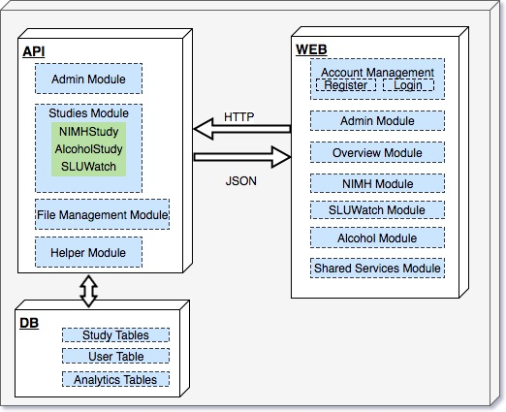
System Implementation
Module Level Architecture Diagram
Notes:
Module level system arch ---
Talk how you split up everything into different modules from the high level architecture.
This made development easy
HTTP communication via AJAX calls
DB resides on the same server so delay is cut short during requests

Slide 18
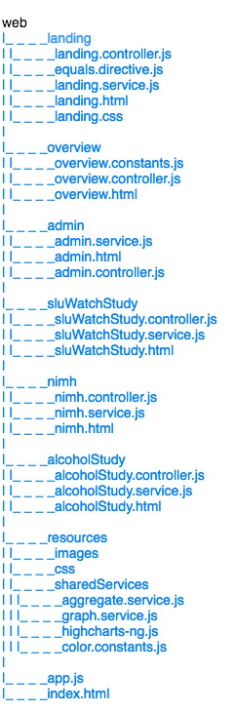
File System Hierarchy
Previous Implementation - Every entity in one folder
Current Enhancements – As shown, separating into modules
Makes development easy- As lesser dependencies
S.O.L.I.D – Single Responsibility Principle
Monolithic vs Modular Approach
Notes:
At first everything was in one folder – even for MTD
mAAS has all the html, css, php,js in one .php file, no separation of entities
Single Responsibility Principle
File system diagram
Every module
stress on shared services( service oriented architecture)
dependency injection
Provides separation of concerns which means easy to test, easy to build, dependency injection among shared modules

Slide 19
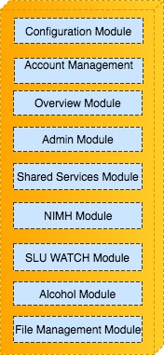
Lower level modules
Help in running of the overall app
Configuration Module - app.js, PHP classes for DB and app, index.html, AWS
Account Management Module - Login, Register, E-mail confirmation
Admin Module - Get all users, Approve and Revoke access, provide permissions
Overview Module - Landing Page and acts as interface for every other Module
RESTful end points for all these functionalities

Slide 20
Shared Services Module
GraphService - for drawing similar study graphs using highcharts-ng directive
AggregateService - for performing similar aggregations across all the studies for different metrics
LoginService - to allow user actions and credentials across whole app
PHP Helper files shared in back-end
Services for every study to share and relay data
Notes:
Shared services can be
across the app
across a module
depending upon where the functionality was it was residing there
graphService → Set of functions for drawing different graphs. highcharts-ng works: Open source code, which had to be integrated to work with MTD.
Explain how Html -→ just like any other directive ( title, p, a, div… similarly highcharts was also created because of this)
JS → just create a config file based on specification and properties in Highcharts.com and then pass the object around to services or template
aggregateService -> set of functions for doing aggregations in controllers – total compliance, total surveys, total days, etc
loginService -> Takes care of the login module and user credentials
PHP -> database operations, config, python csv to mysql converter ( open source)

Slide 21
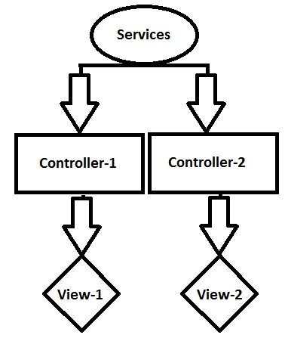
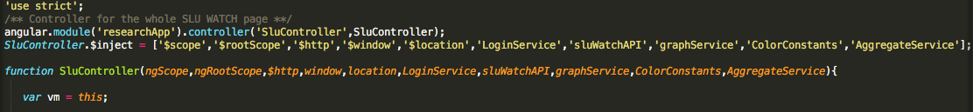
AngularJS Service Oriented Implementation
Service Oriented Architecture
Supports abstraction
Provides Dependency Injection
Ultimately encourages code re-use
Notes:
this is the implementation of SEPARATION OF CONCERNS
In the example snippet SLUContexteroller is being injected with many dependencies and extended
Ideally controller should only manipulate the data, any other requests and response handling should always be done via services, provides a layer provides a layer of abstraction
Helps development( debugging and testing), adds expendability,

Slide 22
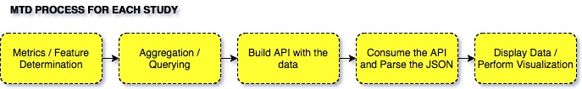
Study Modules
Survey Schema Generalization Approach
Hierarchical Visualization is supported
Study Overview – Study level stats, aggregated
Participant – Individual level stats localized
Process followed for each study module
Notes:
application components / features are determined across all the studies ( metrics , stats , graph types)
Identifying shared components so that development is streamlined and easy
Implement these modules and then independent modules
Maintaining consistency on such level makes app more understandable ( self explanatory) – As mentioned Structure of dashboard was a major consideration
2 levels of visual display – allows the app to be more informative, data is well spread as well as , well aggregated by doing this.
Discuss the requirements( which features are needed, what they denote, how to be displayed, how to be calculated)
Do the querying and aggregation, Build the API using back-nd PHP Return JSON objects – as they are best to work with using JS, parse and pass these around to render the data construction of visuals

Slide 23
NIMH STUDY ( start HERE)
Database Table
Stats studied for displaying
Days In study, Compliance, Survey Count
Mood Change Response ( Positive, Negative, Total)
Cause for Mood Change
DATE functions and Aggregate Functions for querying
Caching of JSON response helped improve network transit by 60%
Notes:
Compliance was average over the study and as well as user level.
SQL functions had to be optimized and queries. Grouping date related queries in one query helped a lot as unnecessary functions hit the db server
Using inbuilt PHP functions to parse and build a response object in JSON which was structured.
Initially, relay of this object across the http request had a lot of delay, thus an alternate approach of using writing the response to a cached json file and updating the file by periodically running the PHP scripts helped reduce the time of transfer by 60%. This was a vital design consideration which affects the running of the application in a positive manner.

Slide 24
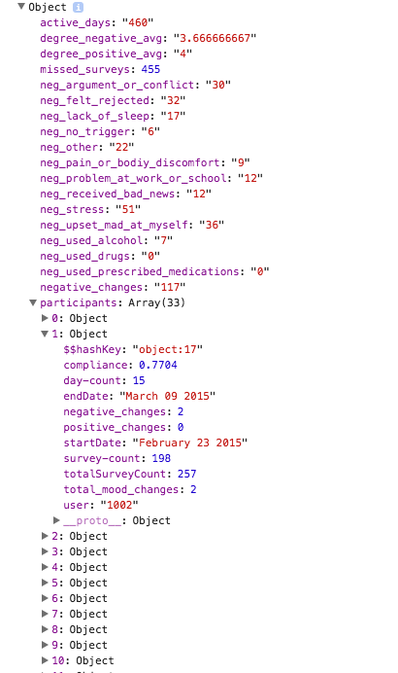
NIMH STUDY (contd.)
JSON parsed in the controller
Build the view
All the participants listed with respective files for download
Notes:
Look at the structured JSON response, helps parse it in the front end well.

Slide 25
SLU WATCH Study
31 participants ( Sensor and Survey)
722,731 records with 124 columns
Larger data = More metrics
Original sampling 1 row /s, sluWatch Table 1 row/min, sluWatchStats 1 row/day reduced to 756 rows
SQL Performance Considerations
Notes:
Give overview / reminder of SLU Watch Basis Study
756 rows for 31 participants, that is approx 25days for each. This is easily verified by the graph accurately.
1. Querying in a way to group by dates meant the query execution was longer, but grouping the fields by user and then by day and then by hour gave quicker results
2. sluWatchStats had aggregated records for all the values making querying easier
3. Thus, indexing the table by the participant and then by the Dates made query execution extremely quicker, for example the queries to get the daily and hourly physiological data individually took about 3-5s, after indexing it came down to around 750ms, that is a roughly 400% decrease in SQL execution time

Slide 26
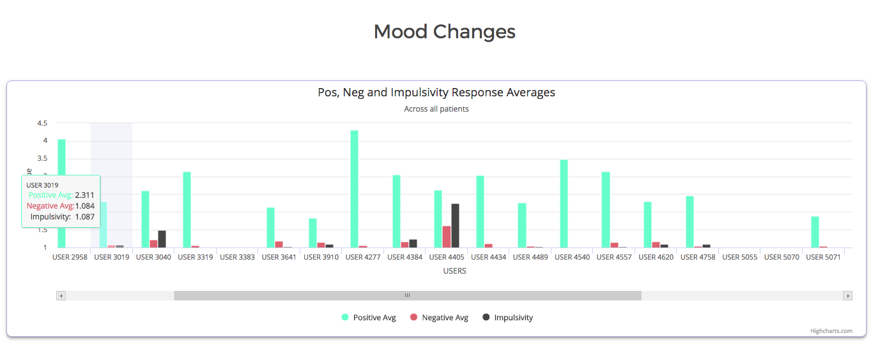
SLU WATCH (contd.)
Separate by Daily and Hourly Metrics
Feed array/ list of values to highcharts object
Divide the JSON response into study level and user level
Files zipped for each participants available for download

Slide 27
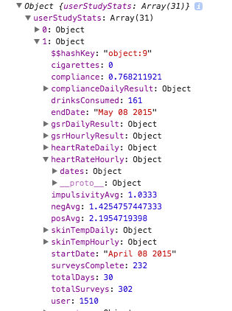
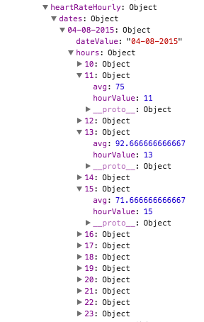
SLU WATCH
JSON RESPONSE STRUCTURE
Example
USER 1510
Notes:
Compliance – (Study Level, participant, For each day in study for every participant)
Days in study
Average response for mood change
positive, negative and impulsivity
Physiological Stats for each participant
GSR – Galvin Skin Response – measured in (μS)
Heart Rate – measured in bpm
Skin Temperature – measured in °F
Substance consumption stats ( cigarettes and drink)
Average usage of substance / participant
Total quantity of consumption for each participant.

Slide 28
ALCOHOL CRAVING STUDY
Similar Questionnaire as NIMH
Lot of common features and similar metrics being studied
Thus, fastest development among the three
13,164 survey records with 192 columns for 24 participants
Overview has users listed with file download and user view link
Notes:
The schema was almost similar to the one in NIMH but the number of participants and the data collected differed, which meant making changes to the API development.
This is where the survey schema generalization came in very handy, the common features and the similarity of metrics being studied made the implementation of this module the quickest among all the three study modules.
The queries changed as column names and table structure changed
Heirarchical view shown along with

Slide 29
FILE MANAGEMENT MODULE
FILE structure based off studies and then sub folders for participants
Incorporated zipping functionality zipHelper.php
Recursive design which can be extended
Easy access rather than individual download
Notes:
Previously was zipped and then placed on server, bad design practice
zipHelper.php ----→ (PHP classes ZipArchive and DirectoryIterator)
All the individual raw survey files can be converted to a single zip.
Can work for a directory, a file etc
Needs to be passed correct locations for it to be run
Placed inside a cron job

Slide 30
DEMO
Screenshots?? or demo? or video recording for 1 minute?

Slide 31
OUTLINE
Introduction
Related Work
Data Overview
Methodology & Implementation
Results
Conclusion

Slide 32
RESULTS ( draw a table)
Secure Application – Registration, Password & Approval based
File Systems ( Monolithic vs Modular)
Previous text files to Graphical UI ( Rich Graphs via Highcharts.js)
3 times faster loading with additional studies
Reliable due to AWS hosting
Unit testing
Successful Implementation of multi level hierarchy for Disparate datasets
Notes:
Compare timings ---- This is because of caching the JSON results
File systems
Monolithic vs heterogeneous approach (modular)
Passwords secure + 2 level authorization
Txt files vs graphs
Multi level hierarchy for disparate datasets
Reliable(ec-2) also scalable
Unit testing ( a good way to test separate features, provided by AngularJS)

Slide 33
OUTLINE
Introduction
Related Work
Data Overview
Methodology & Implementation
Results
Conclusion

Slide 34
CONCLUSION
MTD - A full stack application development approach for a modular mutli-page app
Enriching process with current industry standards
Helpful for research community
Appropriate usage of Survey and Sensor Data
FUTURE WORK
More robust Unit Testing
Highstocks.js for time series graphs
Restrictive access based on permissions
More Studies
Notes:
1. This project encapsulates the full stack development methodology in developing modular multi page web applications for large data sets
2. has involved using some of the newest and popular web development technologies [6] [10], handling large datasets in terms of relational databases and reducing query complexities, all of which has been an enriching process in terms of knowledge gained about web applications architecture and dashboard development.
3. Extensible by adding more studies, requires code change but not too much
4. Helpful for research community ( state tim and ryan interest)
Future work
- More robust unit testing, highstock and restrictive access based on permissions and of course more studies.

Slide 35

Slideshow credits

Slide 36

Thank You!
Questions?

